Slide 1
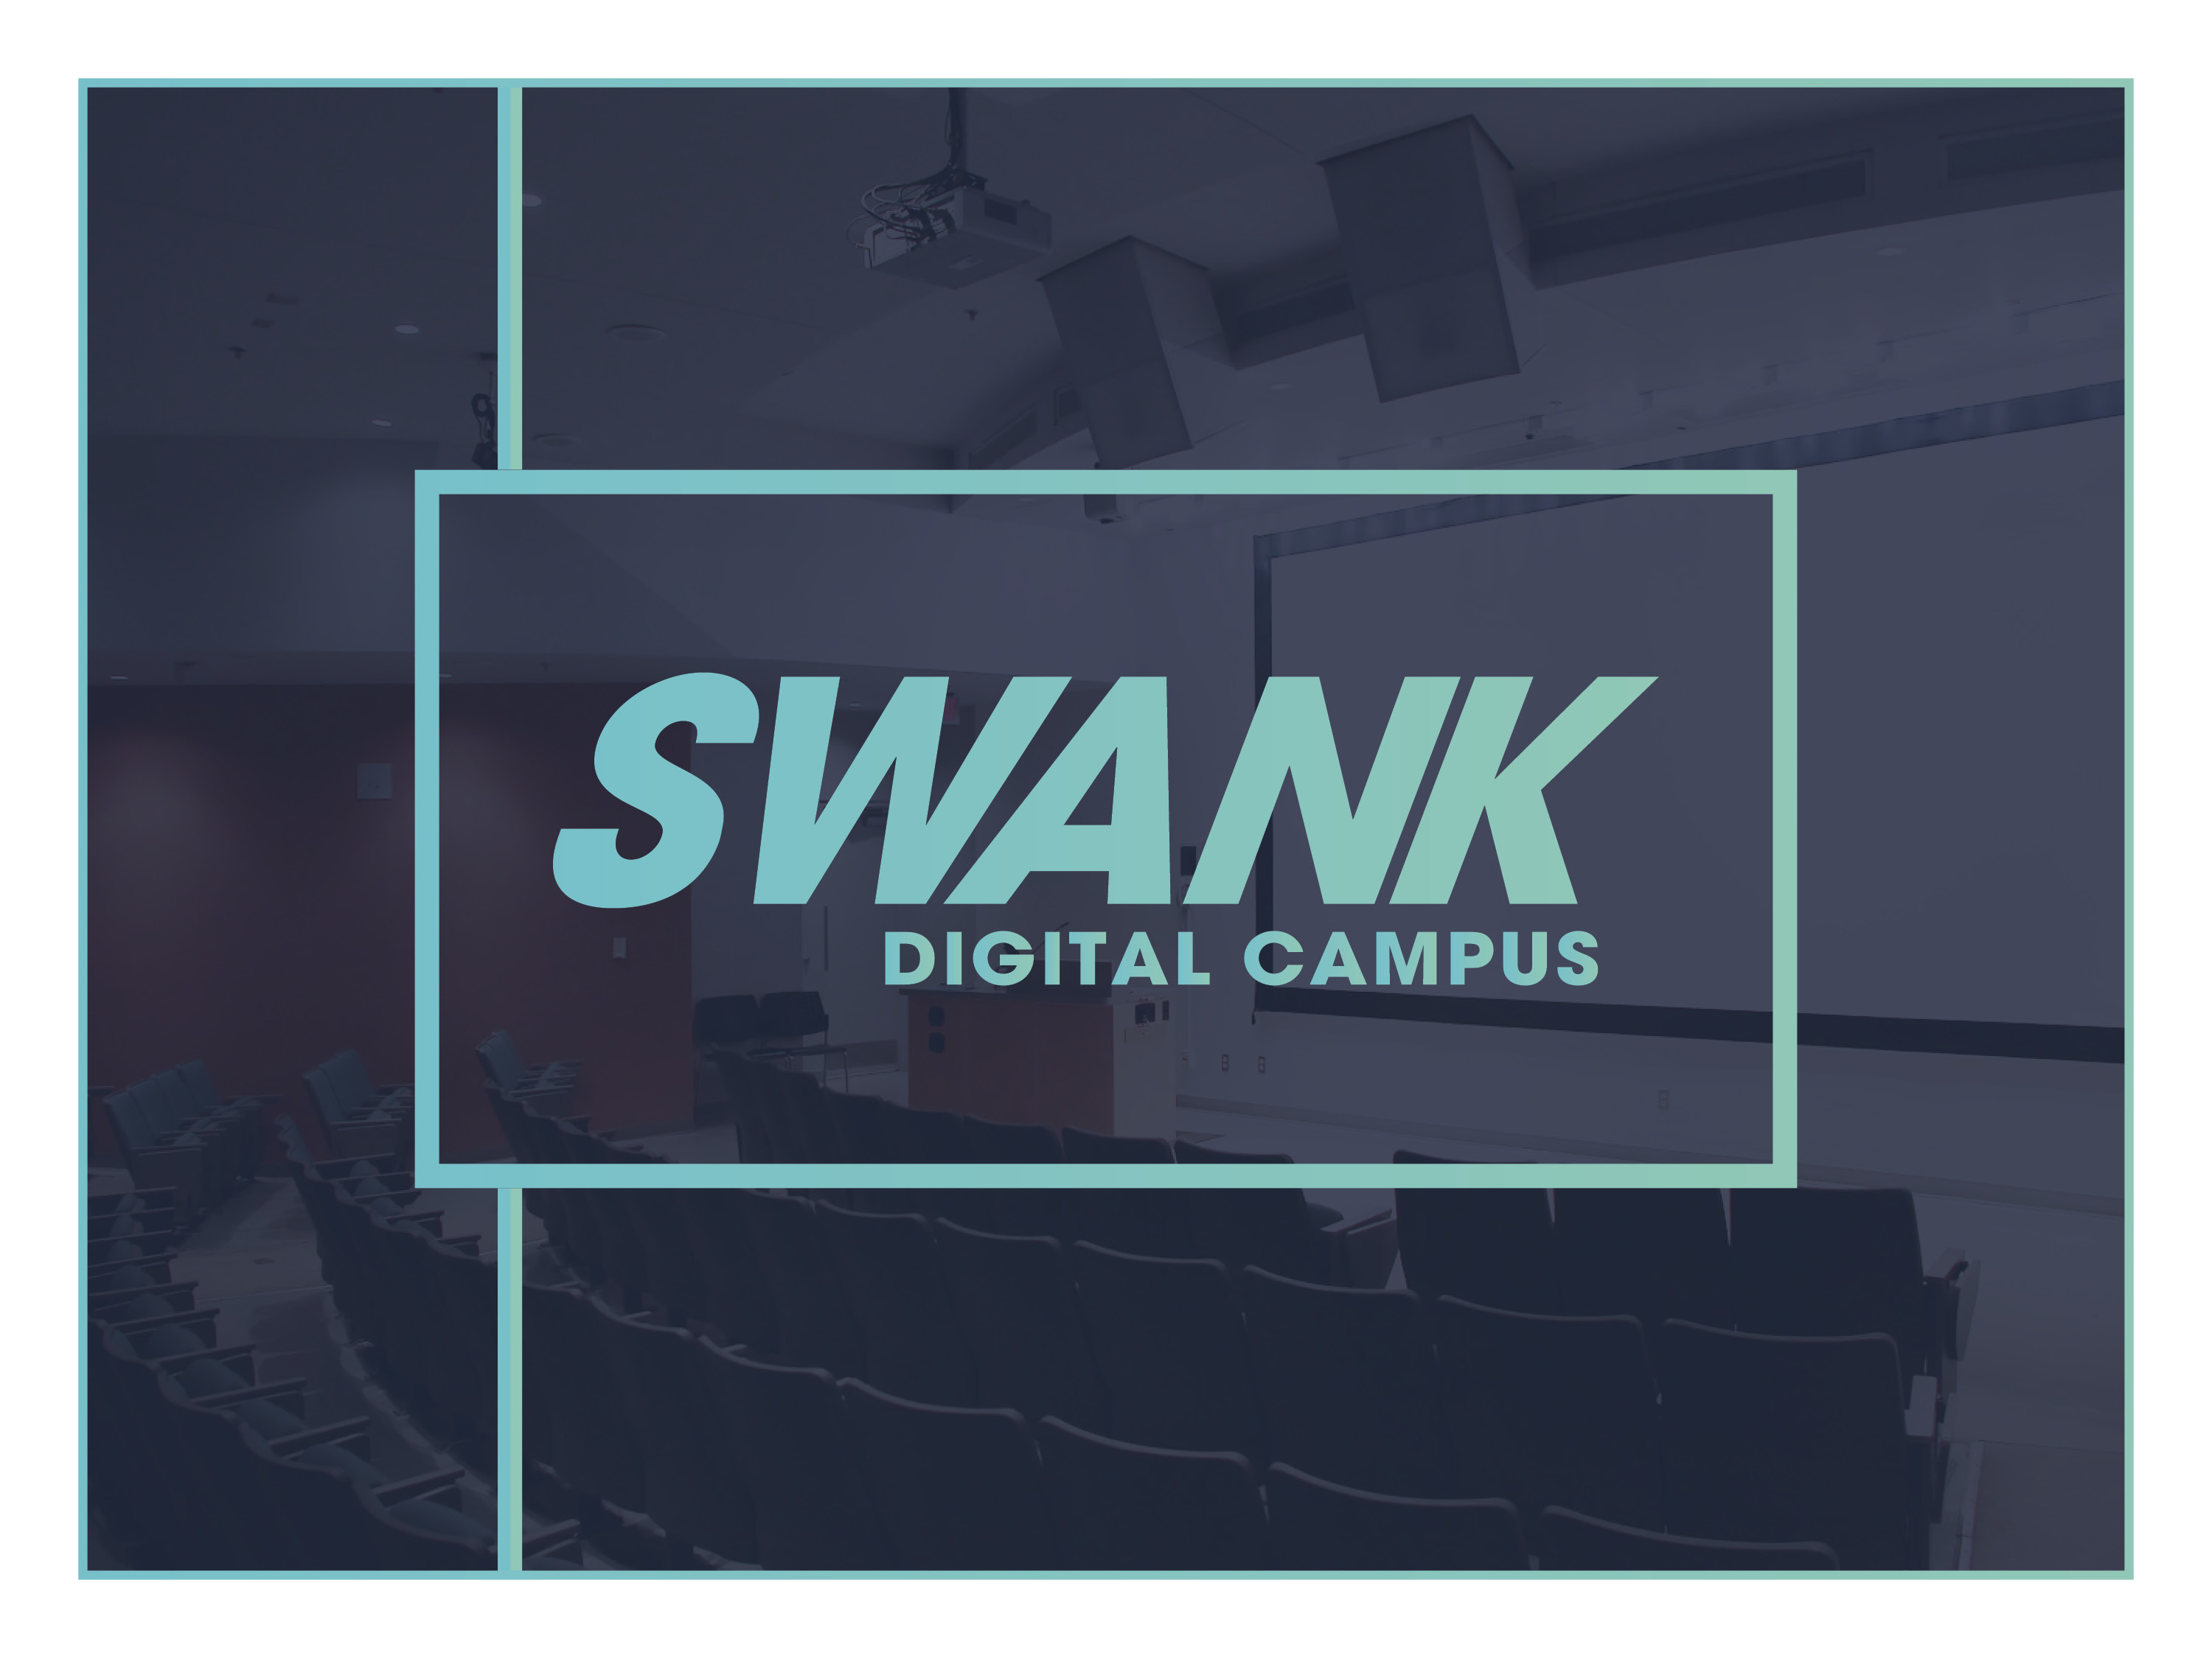

Slide 2

WHAT IS IT?
SWANK DIGITAL CAMPUS allows professors to stream films inside the classroom or assign to students as homework:
• Includes film from major Hollywood studios, documentary providers, independent
filmmakers and international film companies
• More than 25,000 classic and well-known titles available to match any course
ACCESS the portal at SWANK on your computer or download the app for your mobile device
REQUEST titles for your classroom through the Swank portal

Slide 3
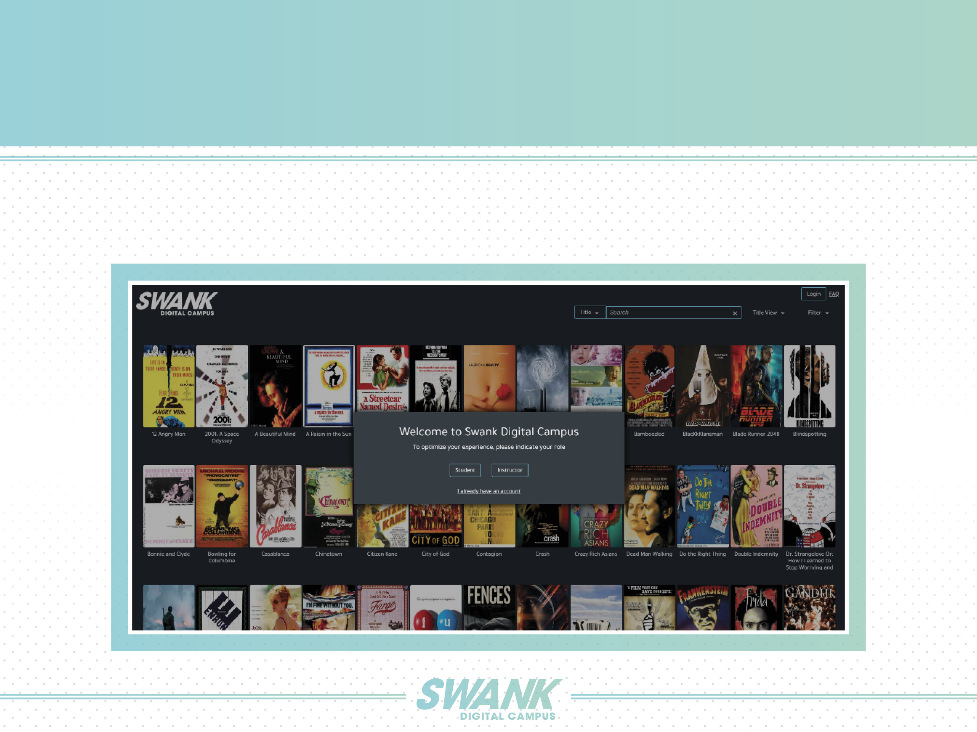
HOW DO I START?
When prompted, instructors should self-identify as an instructor in order to search content.
Instructors will need to create an account to request a title.

Slide 4
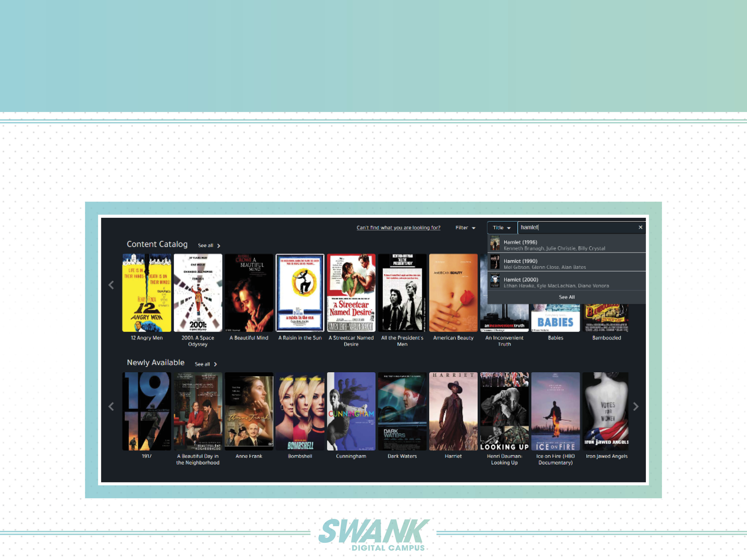
HOW TO REQUEST CONTENT
SEARCH:
Users can search by title, person (cast or director), license status, language, rating, release decade, subject and theme.

Slide 5
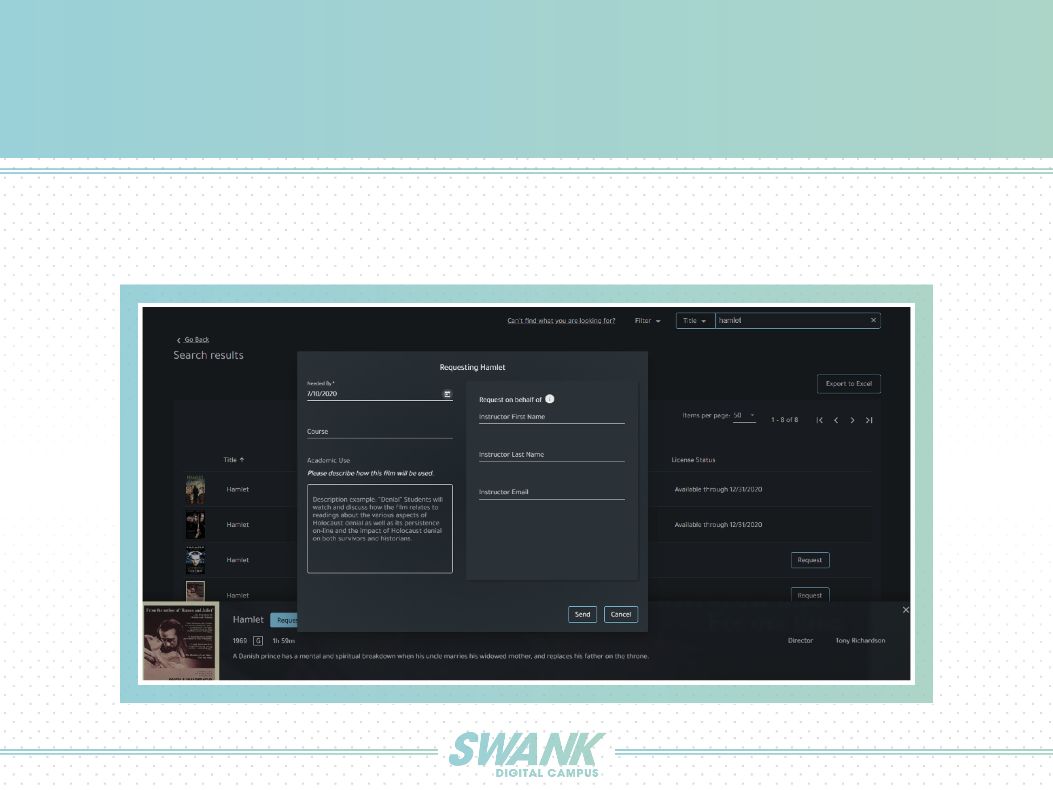
HOW TO REQUEST CONTENT
REQUEST:
If the film is not already licensed, select the “Request” button and fill out the pop-up form with additional information.
Please allow 48 hours for new titles to appear in the portal.

Slide 6
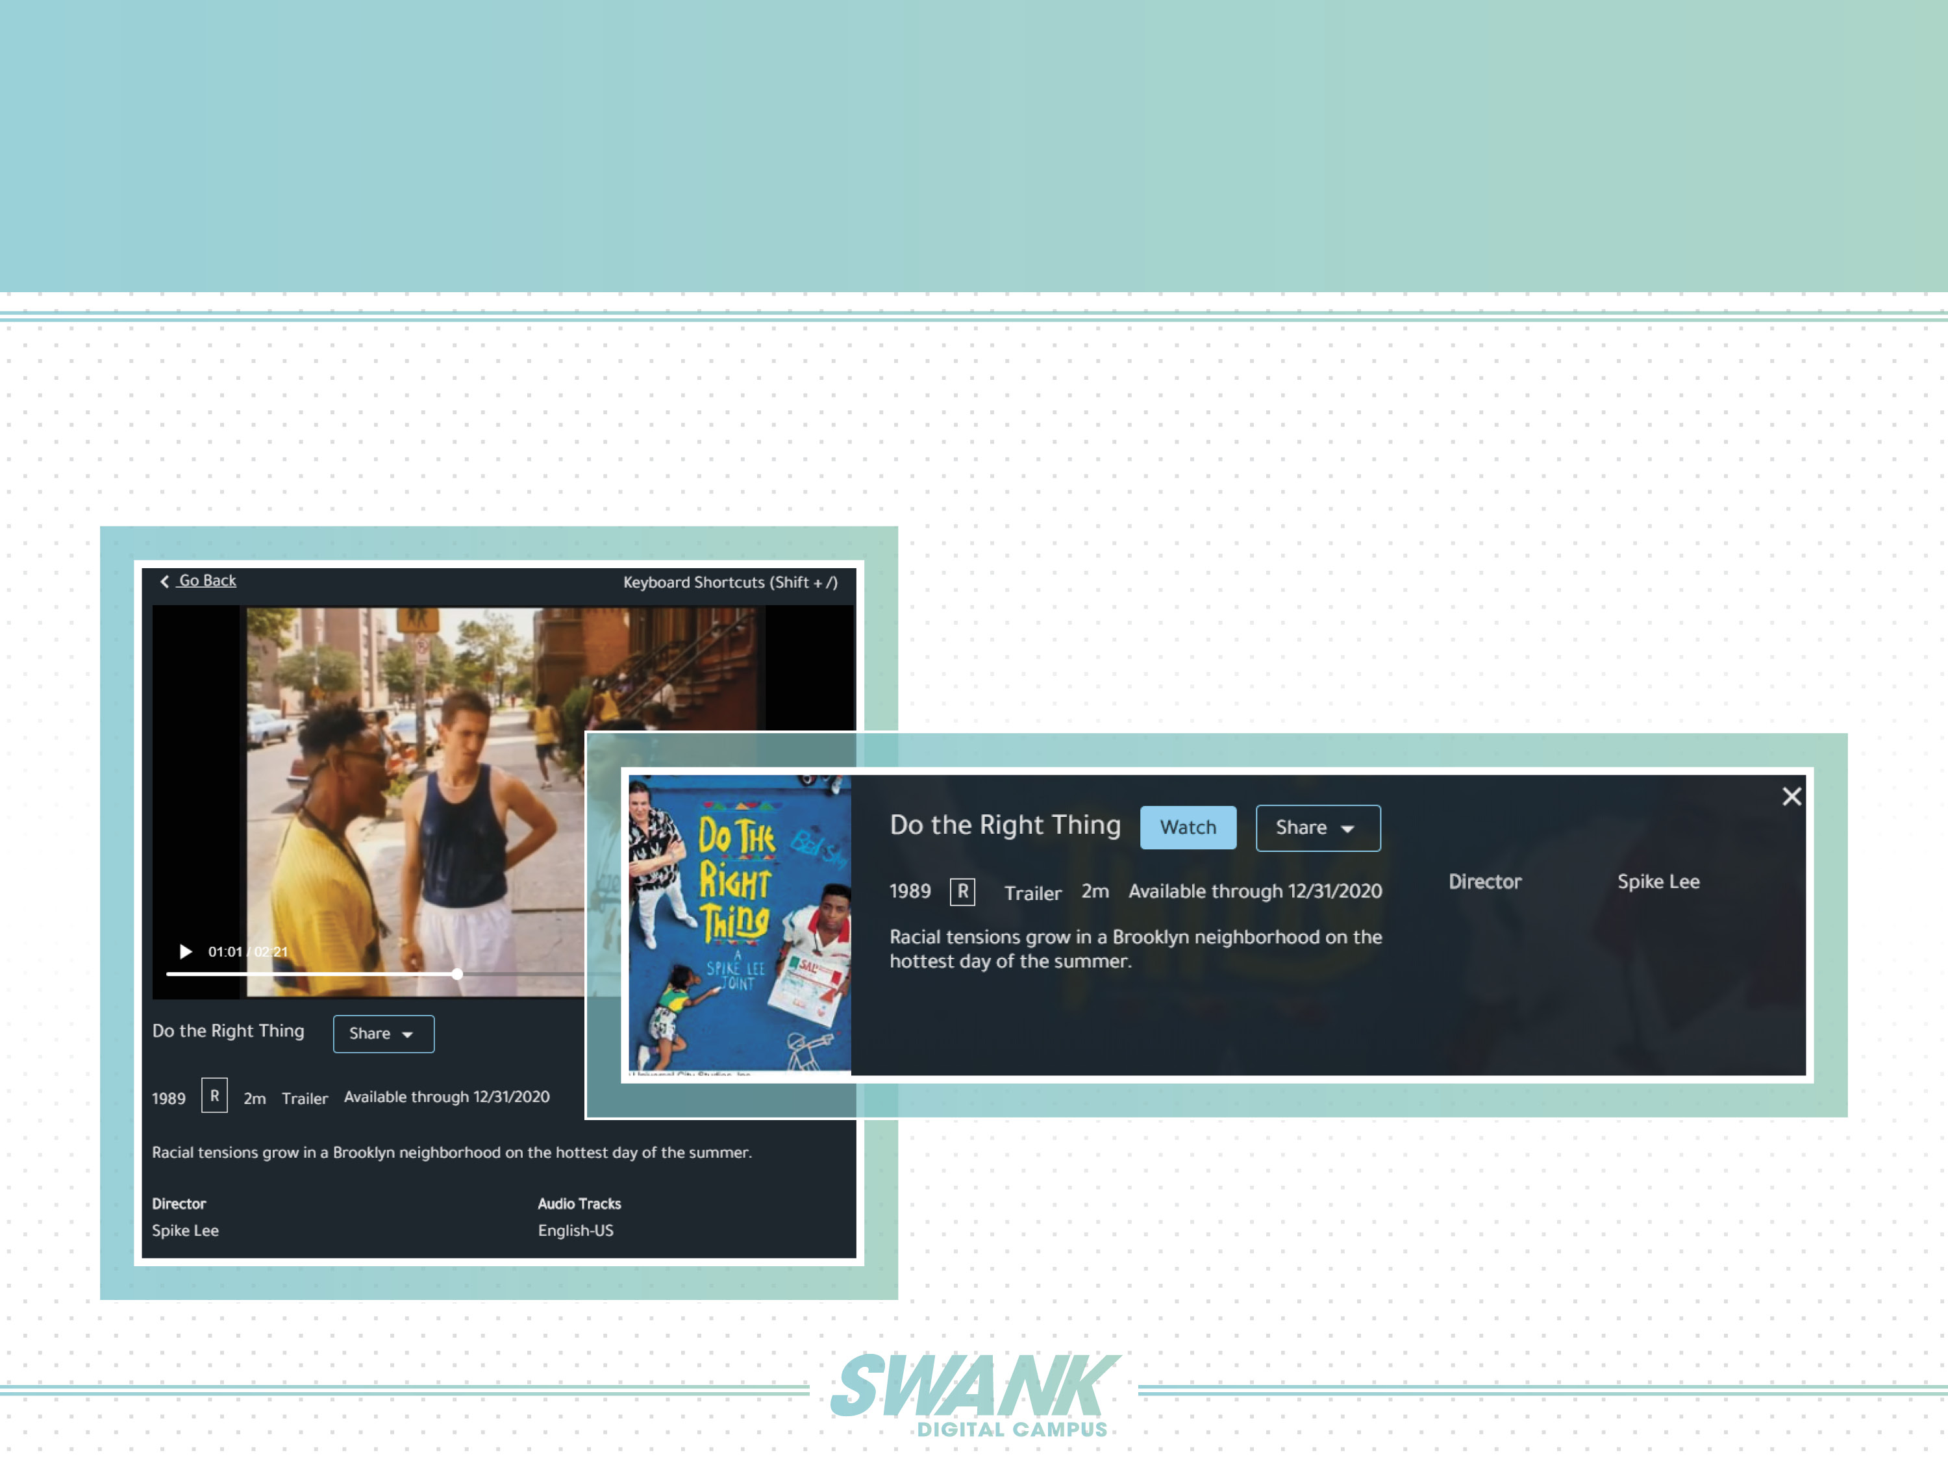
HOW TO WATCH FILMS
WATCH:
Use the “Watch” button to preview during your lesson planning or stream the film for in-person classes.

Slide 7
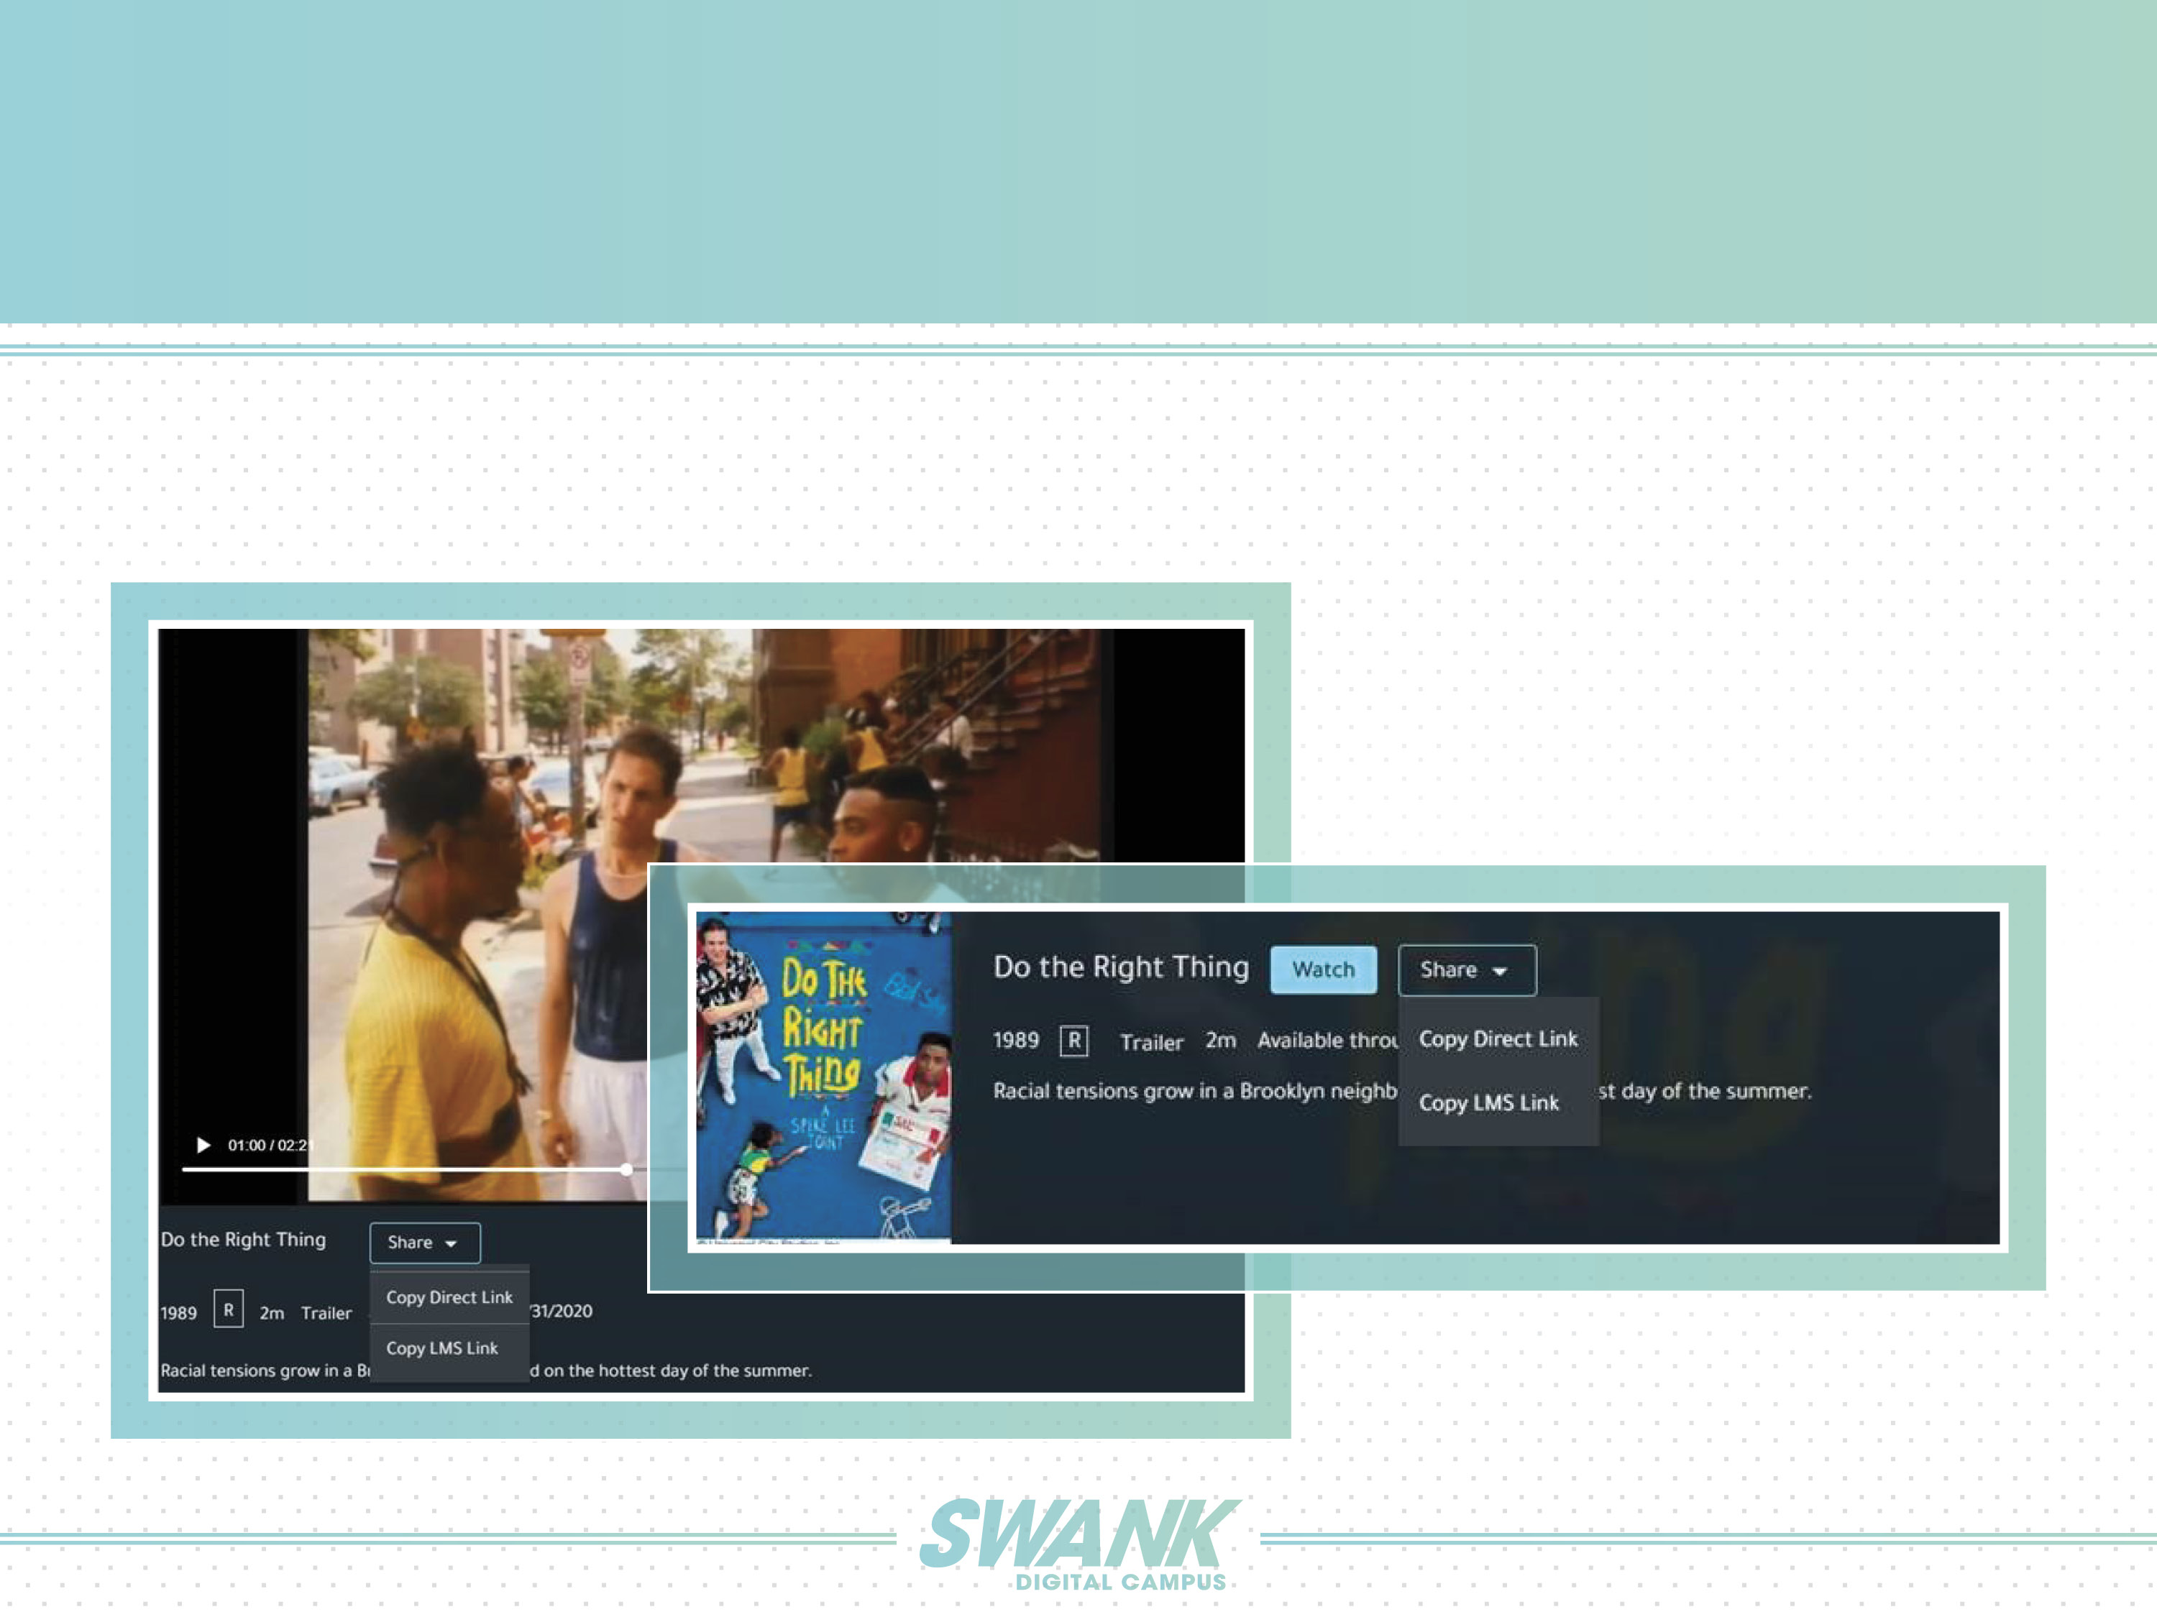
HOW TO ASSIGN FILMS
ASSIGN:
For viewing outside the classroom, use the "Share" button to send the film's direct link to students or embed in an LMS.

Slide 8
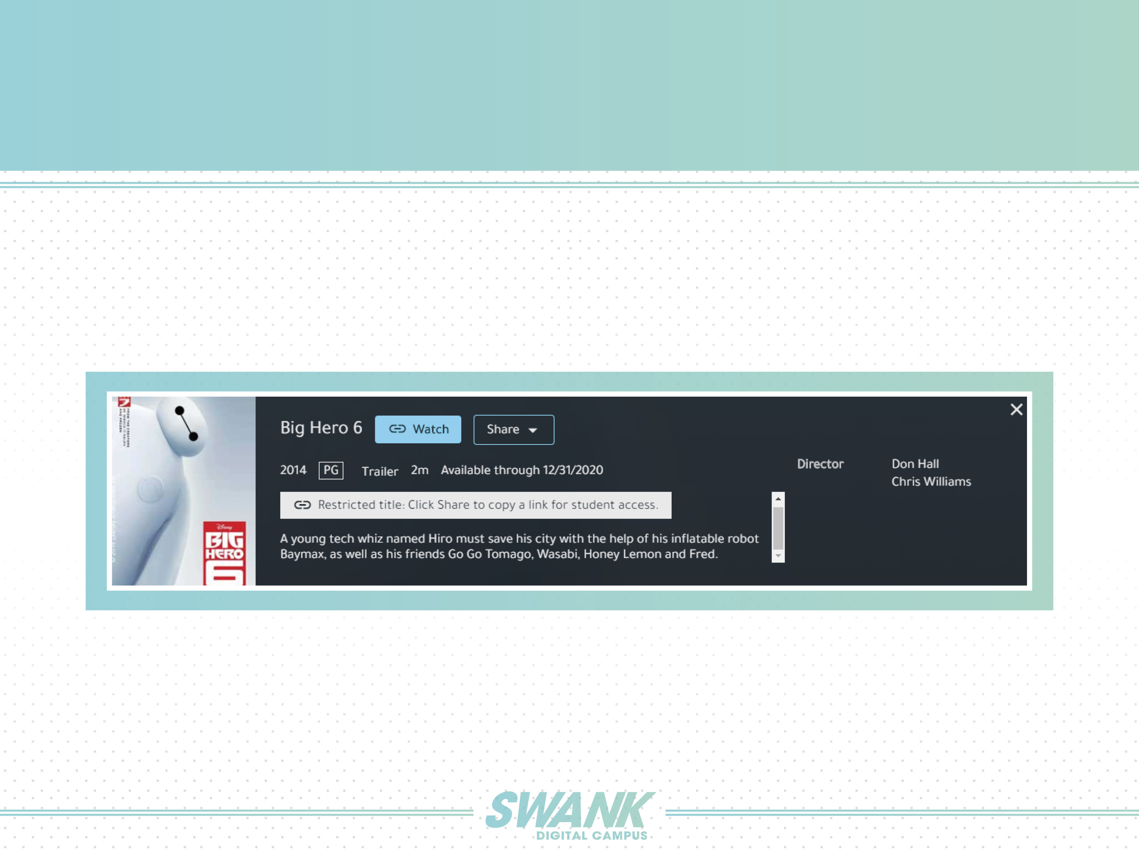
RESTRICTED TITLES
A small number of films with the Digital Campus library have additional restrictions on them as indicated below.
There is no difference in access to these films for Admin and Instructor roles, however, students will not see these films
in the general Swank library. They will need to be provided with a Direct Link or LMS link in order to view.

